Slide 1

AI for Coders: Write, Explain, & Debug
Unlock your potential with AI-powered coding techniques.

Slide 2

MODULE 5
Prompting for Coding & Debugging
By the end of this module, you will master using AI to understand, write, debug, and optimize code efficiently.
Convert Logic to Clean Code
Secure, Scalable, Optimized Solutions
Architectural Thinking
Transform abstract ideas into executable, well-structured code.
Develop robust software that stands the test of time and usage.
Move beyond syntax to design comprehensive system architectures.

Slide 3


1. Prompts for Explaining Code
Why This Matters:
Developers frequently encounter unfamiliar code—be it legacy systems, open-source projects, interview problems, or production bugs. AI can transform into your personal code reviewer and tutor, clarifying complex logic instantly.
Basic Explanation Prompts
Advanced Explanation Prompts
Explain this code line by line.
Explain this code in simple terms for a beginner.
Explain this code assuming I know DSA but not this language.
Explain the time and space complexity of this code.
What edge cases does this code handle or miss?
Refactor this code and explain the improvements.
Teaching Tip: Encourage learners to paste code and add context (language, level, goal) for best results.

Slide 4
2. Prompts for Generating Code
Why This Matters:
AI's code generation capability is powerful, but its effectiveness hinges on clear and precise requirements. A well-crafted prompt makes all the difference.
❌ Poor Prompt Example
✅ Good Prompt Example
Write code for login system
Write a login system in Java using Spring Boot. Requirements: - JWT authentication - Password hashing - Role-based access - MySQL database
This prompt is too vague and lacks essential details, leading to generic or unsuitable code.
Specific constraints guide the AI to produce relevant and high-quality code.
1
2
Common Code Generation Prompts
Constraint-based Prompting
Generate a clean and optimized solution for this problem.
Write production-ready code with proper error handling.
Solve this problem in O(n) time and O(1) space.
Generate unit tests for this function.

Slide 5
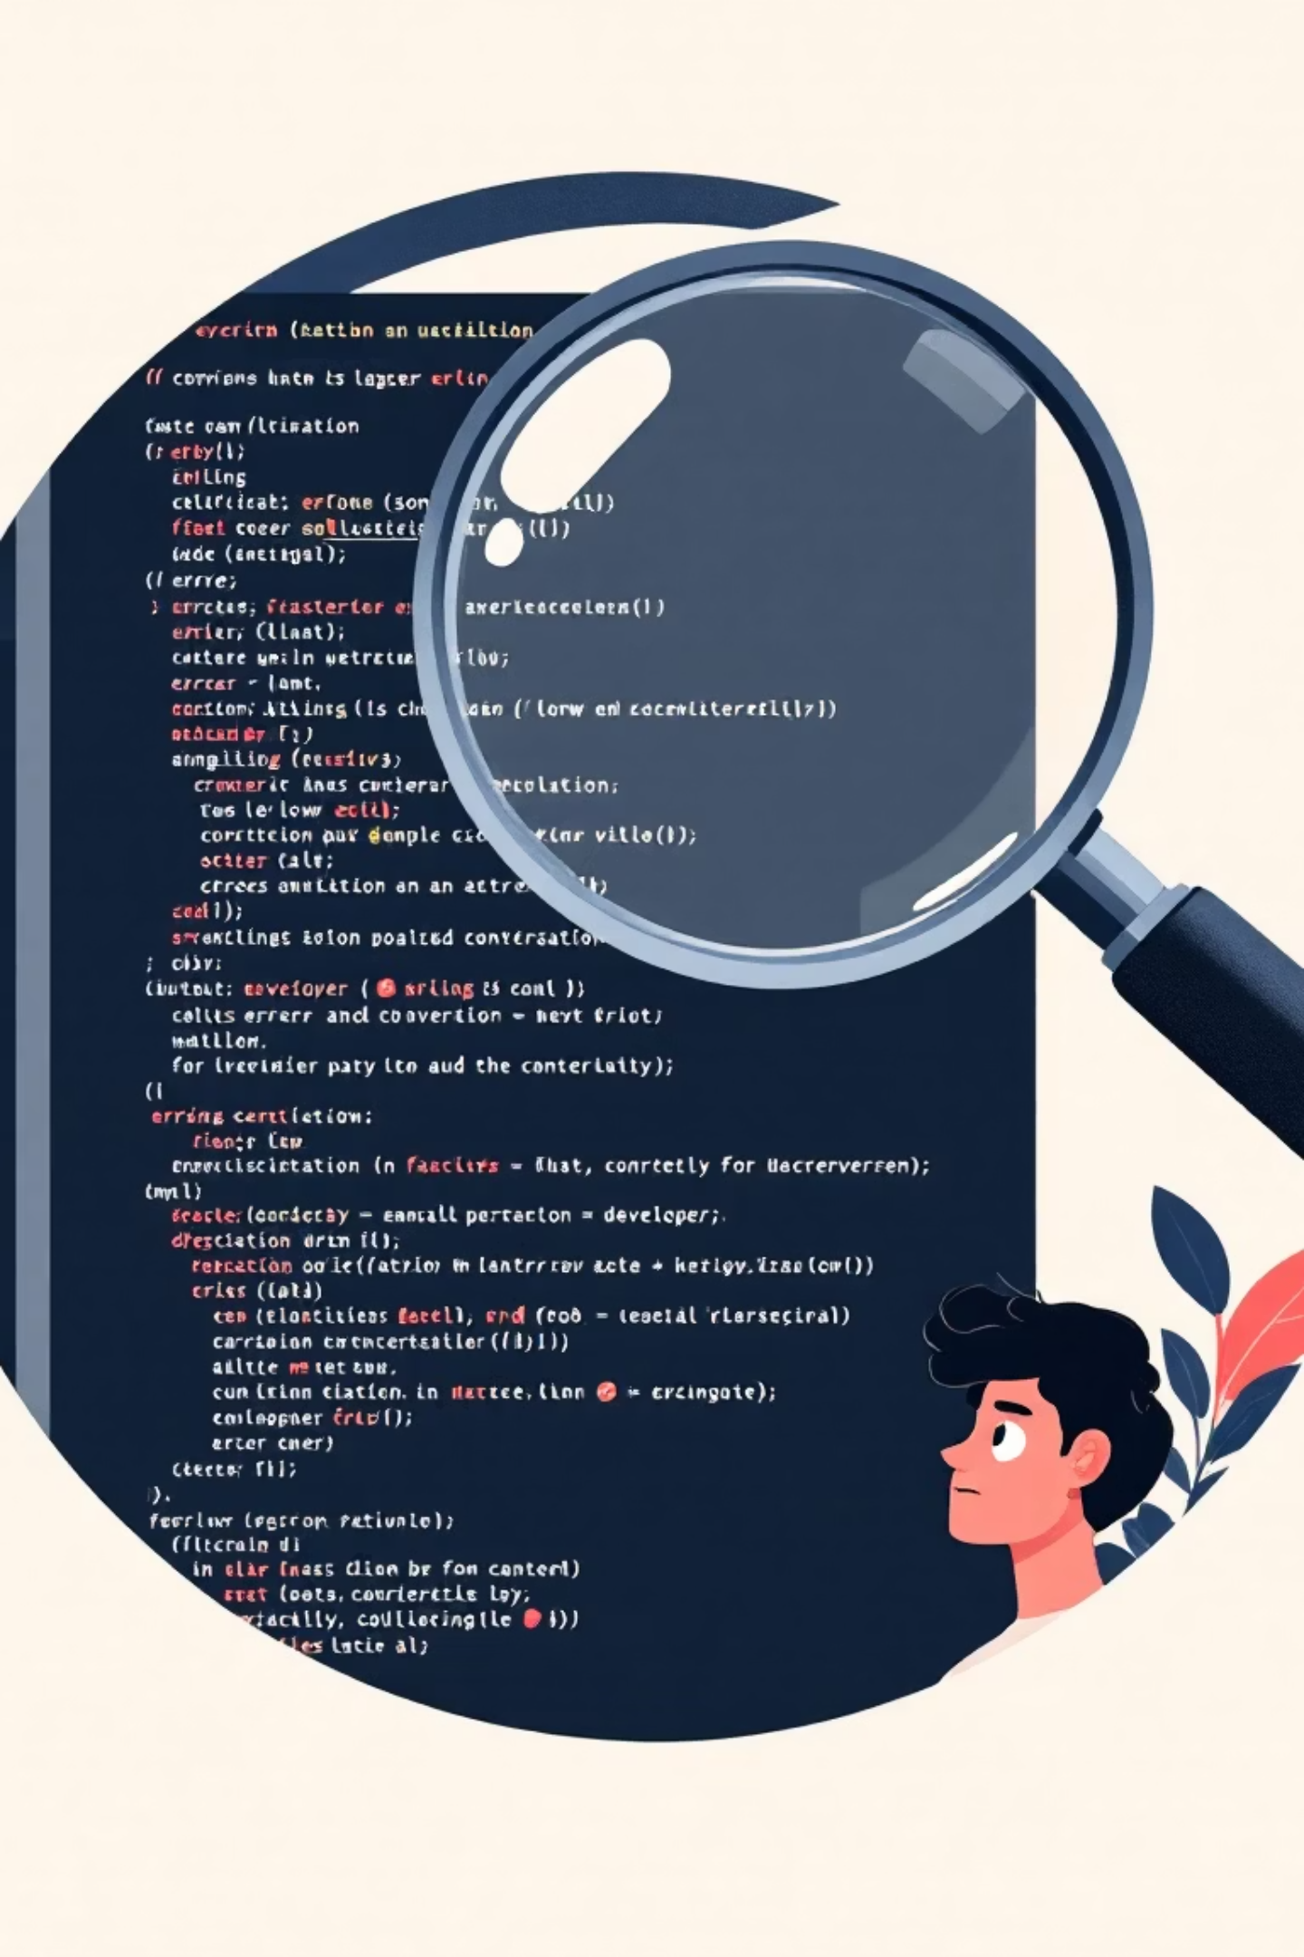

3. Prompts for Debugging Code
Why This Matters:
Debugging consumes a significant portion (30-50%) of a developer's time. AI can drastically reduce this overhead by quickly identifying and explaining issues.
Basic Debugging Prompts
Advanced Debugging Prompts
Find the bug in this code.
Why is this code giving wrong output?
Why am I getting this runtime error?
Explain why this solution fails for edge cases.
Debug this code without changing its structure.
Compare my solution with an optimal one and point out mistakes.
Stack Trace Prompting: Provide the error message and stack trace. Ask AI to explain the root cause and suggest a fix.

Slide 6
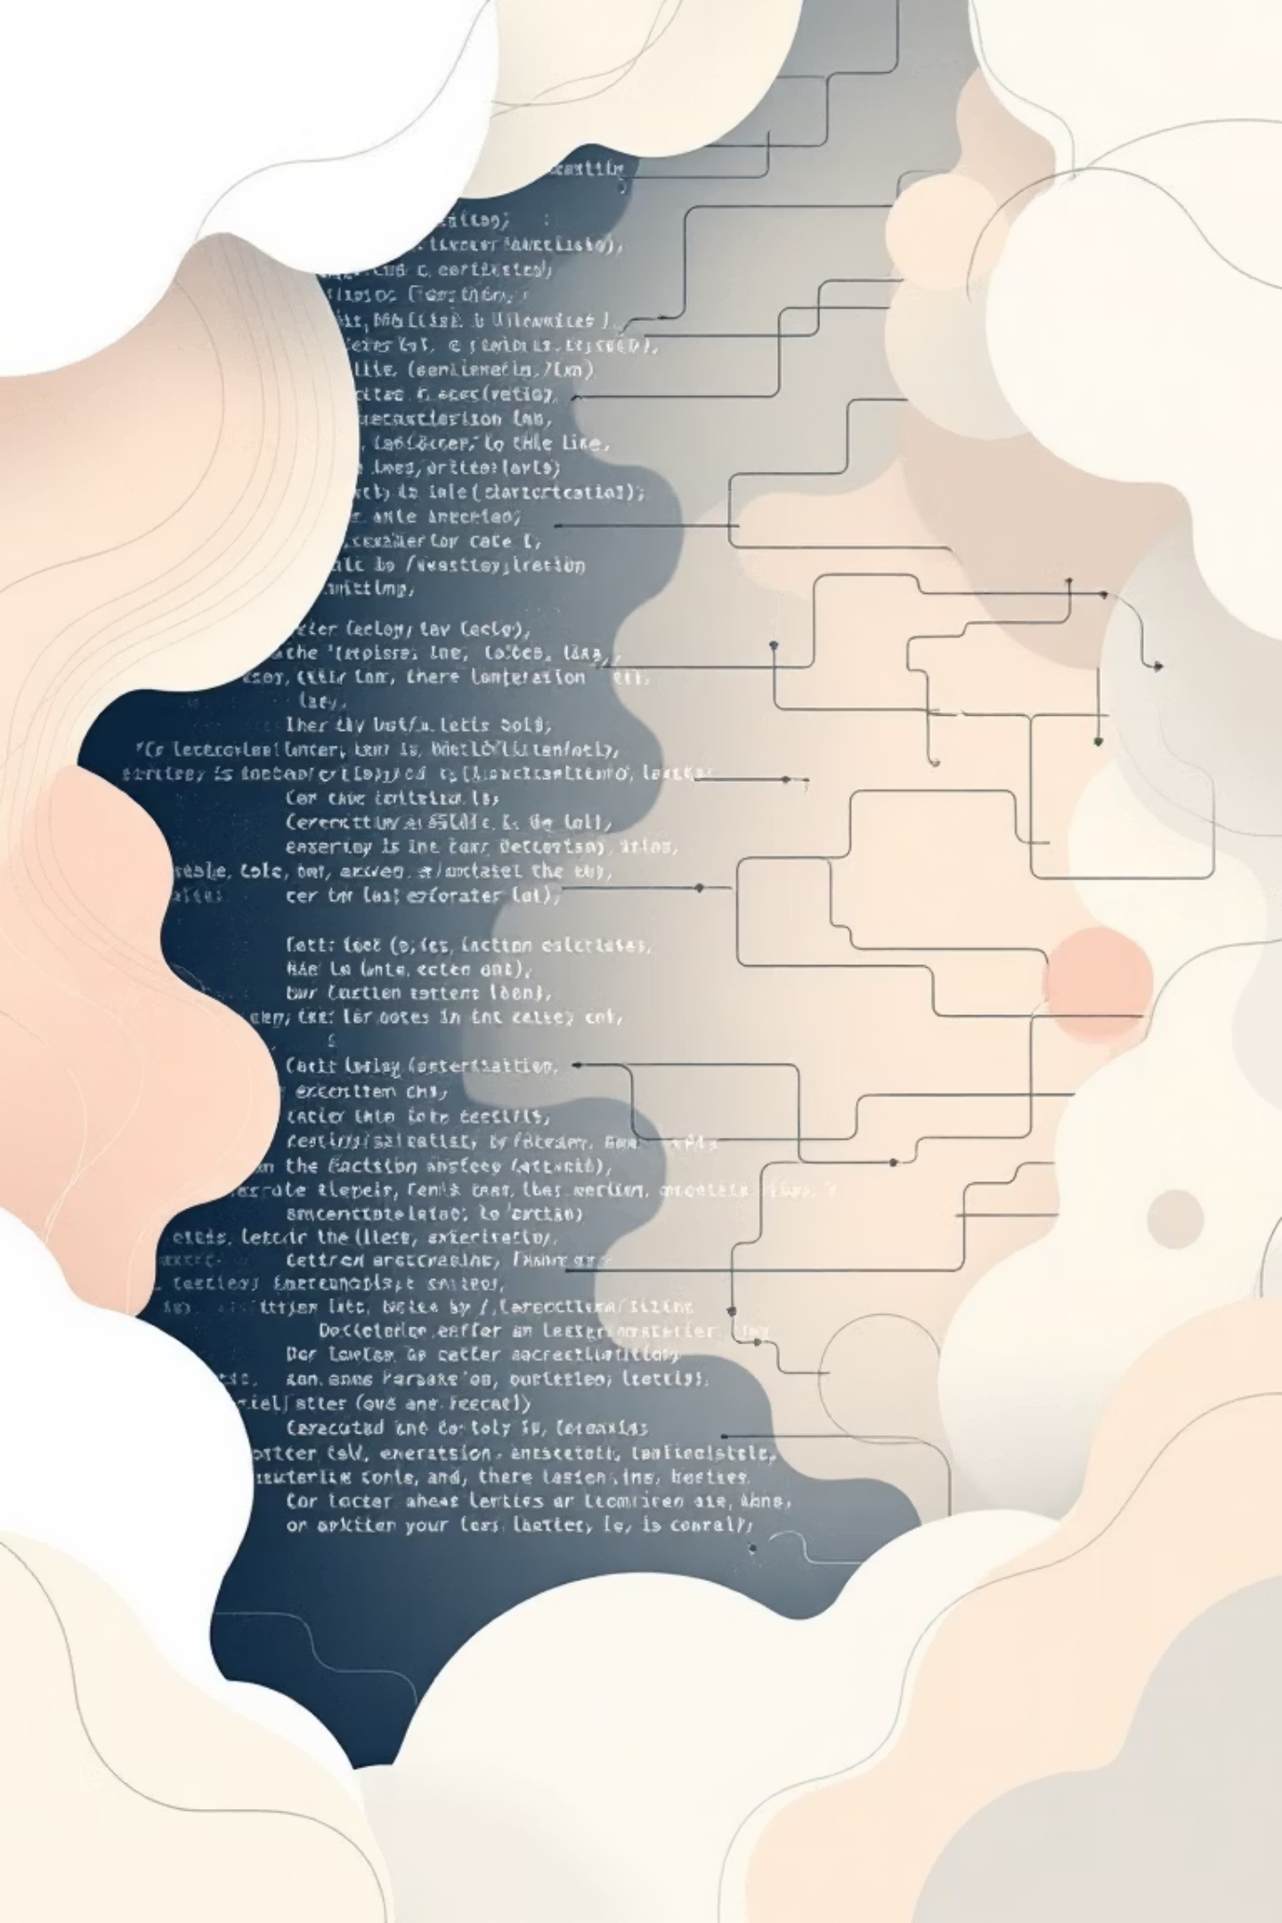
4. Prompts for Converting Logic to Code
Why This Matters:
Many learners grasp algorithmic logic but struggle with its practical implementation in specific programming languages. AI bridges this gap, acting as a powerful translator.
Logic → Code Prompts
Convert this algorithm into C++ code.
Convert this pseudocode into Python.
Translate this flowchart into Java code.
Step-by-Step Prompting
First explain the approach, then write the code.
Break the solution into functions and then implement them.
For interview preparation, try prompts like: "Write interview-ready code with comments and a dry run."

Slide 7

5. Secure Coding Prompts
Why This Matters:
Security vulnerabilities lead to real-world failures and significant costs. AI can act as an early warning system, identifying potential issues before they escalate into critical problems.
Secure Coding Prompts
Security-Specific Use Cases
Review this code for security vulnerabilities.
Is this code vulnerable to SQL Injection or XSS?
Rewrite this code following secure coding practices.
Add input validation and sanitization.
Secure this REST API.
Implement password hashing and salting.
Prevent race conditions in this code.

Slide 8

6. Architecture-Level Prompting
Why This Matters:
Senior engineers excel at thinking beyond individual components, considering scalability, fault tolerance, and design patterns. AI can assist in exploring and validating architectural decisions.
Architecture Design Prompts
Design a scalable architecture for an e-commerce application.
Suggest system architecture for 1M concurrent users.
Design this system using microservices.
Comparison Prompts
Compare monolithic vs microservices for this use case.
Which design pattern fits this problem and why?
Design this system assuming AWS cloud deployment.

Slide 9

7. Improving Time & Space Complexity
Why This Matters:
Optimization is a hallmark of an exceptional developer. AI can help refine your solutions to meet demanding performance requirements.
1
Optimization Prompts
Request AI to optimize solutions for time complexity, reduce space complexity without changing logic, or suggest better algorithms.
Optimize this solution for time complexity.
Reduce space complexity without changing logic.
Is there a better algorithm for this problem?
2
Comparative Prompting
Compare different approaches (brute force vs. optimized) and explain why one is superior. Ideal for interview preparation.
Compare brute force vs. optimized approach.
Explain why this solution is better than mine.
Optimize this code to pass large input constraints.

Slide 10

8. Best Practices for Prompting
Follow these golden rules to maximize AI's effectiveness in coding tasks.
✅ Be Specific
Instead of "Fix this code," try "Fix this code for runtime error and optimize it for O(n)." Detail leads to precision.
✅ Add Constraints
Specify language, complexity, style, and use case (e.g., interview vs. production) to tailor AI's output.
✅ Ask for Explanations
Always ask "Explain why this approach works" to deepen your understanding and validate AI's suggestions.
Module Outcome: You can now leverage AI as a senior coding partner, debug faster, write optimized & secure code, and think beyond syntax to architecture and performance.

